Slide 1



Welcome you all
Course: CSS
Day 1 (Session 1)
M.Chitradevi
Technical Trainer,
KG Micro College
KGiSL Campus, Coimbatore – 641 035.

Slide 2


Slide 3
CSS is a language for specifying how documents are presented to users — how they are styled, laid out, etc.
A document is usually a text file structured using a markup language — HTML is the most common markup language, but you may also come across other markup languages such as SVG or XML.
Presenting a document to a user means converting it into a form usable by your audience. Browsers, like Firefox, Chrome, or Edge, are designed to present documents visually,.
For example, on a computer screen, projector, or printer.

Slide 4
CSS can be used for very basic document text styling .
for example, for changing the color and size of headings and links.
It can be used to create a layout .
for example, turning a single column of text into a layout with a main content area and a sidebar for related information.
It can even be used for effects such as animation.

Slide 5

CSS (Cascading Style Sheets)is used to apply styles to web pages. Cascading Style Sheets are fondly referred to as CSS.
It is used to make web pages presentable.
The reason for using this is to simplify the process of making web pages presentable. It allows you to apply styles on web pages.
More importantly, it enables you to do this independently of the HTML that makes up each web page.

Slide 6

Why we learn CSS?
Styling is an essential property for any website. It increases the standards and overall look of the website that makes it easier for the user to interact with it.
A website can be made without CSS, as styling is MUST since no user would want to interact with a dull and shabby website.
So for knowing Web Development, learning CSS is mandatory.

Slide 7
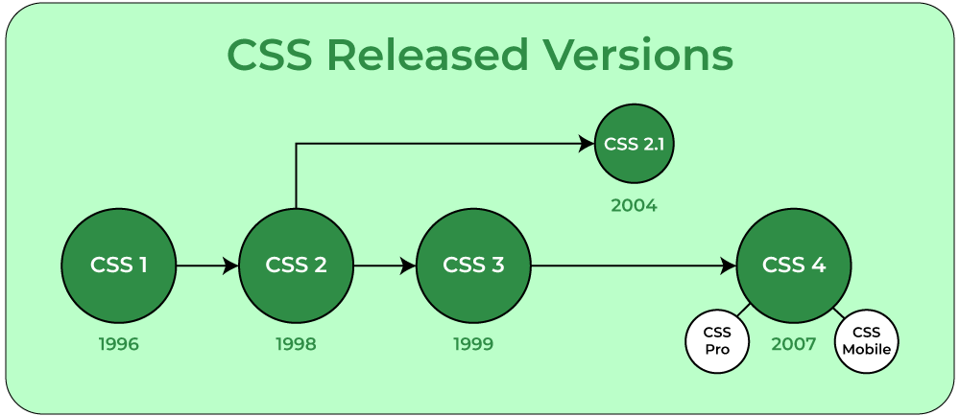

Slide 8
How CSS is different from HTML?
HTML is used to define a structure of a web page whereas CSS is used to style the web pages by using different styling features.
HTML consists of tags inside which text is enclosed and CSS consists of selectors and declaration blocks.
CSS can be internal or external depending upon the requirement.
We cannot use HTML inside a CSS sheet but we can use CSS inside an HTML document.
CSS has comparatively higher backup and support than HTML.

Slide 9
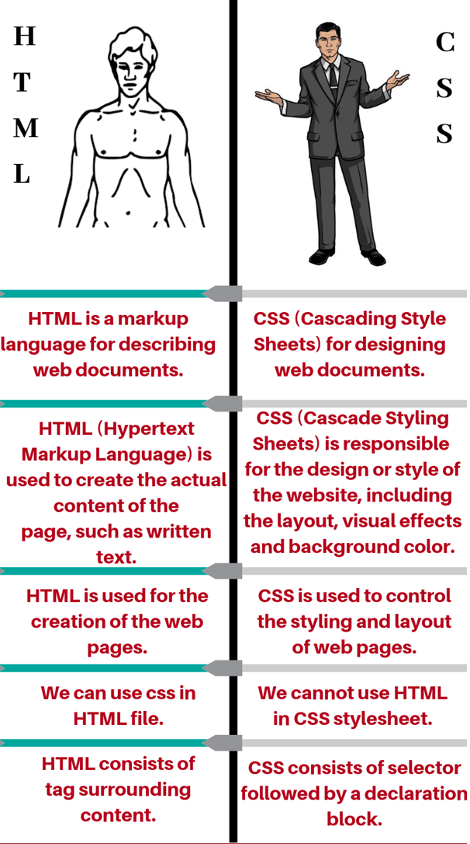

Slide 10
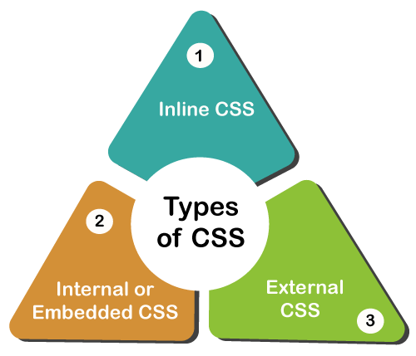

Slide 11
Inline: Inline CSS contains the CSS property in the body section attached with the element known as inline CSS.
Internal or Embedded: The CSS ruleset should be within the HTML file in the head section i.e the CSS is embedded within the HTML file.
External: External CSS contains a separate CSS file that contains only style property with the help of tag attributes.

Slide 12
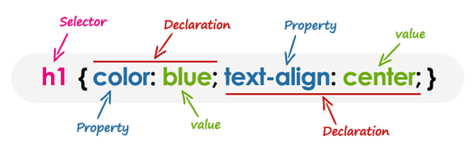
CSS Syntax
Understanding CSS Syntax
A CSS stylesheet consists of a set of rules that are interpreted by the web
browser and then applied to the corresponding elements such as paragraphs,headings, etc. in the document.
A CSS rule have two main parts, a selector and one or more declarations:

Slide 13
Inline
When you use inline, snippets of CSS are written directly into the HTML code and applied to only a single line of code.
<h2 style=”font-size:22px;color:green;”>This is a headline.</h2>
This line of code makes one specific headline on a .html page green and in 22 point font.

Slide 14
Internal
Internal is CSS instructions written directly into the header of the .html page. You want to go this route if one page on your website is going to have its own unique look separate from the rest of your site.
<head> <style>
body {background-color:orange;} p {font-size:24px; color:white;}
</style> </head>
This page will have an orange background with paragraphs sized at 24 point and white font.

Slide 15
External
External CSS is saved as .css files and can be used to determine the appearance of the entire website with just one file.
To use, your .html files need to include a header section that links to the external sheet. It would look like this:
<head> <link rel=”stylesheet” type=”text/css” href=style.css”> </head>
In this case, style.css is the external style sheet.
External is the efficient method for implementing CSS on a website, plus it’s easy to keep track and implement style.

Slide 16
Inside a subdirectory called styles inside the current directory
<link rel="stylesheet" href="styles/style.css" />
Inside a subdirectory called general, which is in a subdirectory called styles, inside the current directory
<link rel="stylesheet" href="styles/general/style.css" />
Go up one directory level, then inside a subdirectory called styles
<link rel="stylesheet" href="../styles/style.css" />

Slide 17
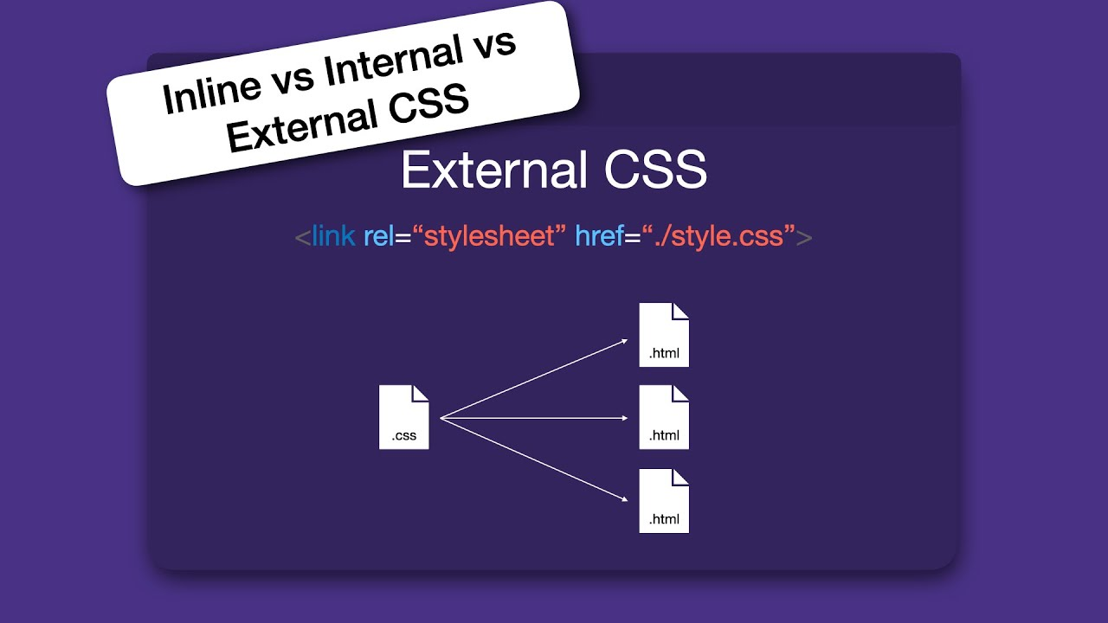

Slide 18
Internal
<head> <style>
body {background-color:orange;} p {font-size:24px; color:white;}
</style> </head>
Inline
<h2 style=”font-size:22px;color:green;”>This is a headline.</h2>

Slide 19
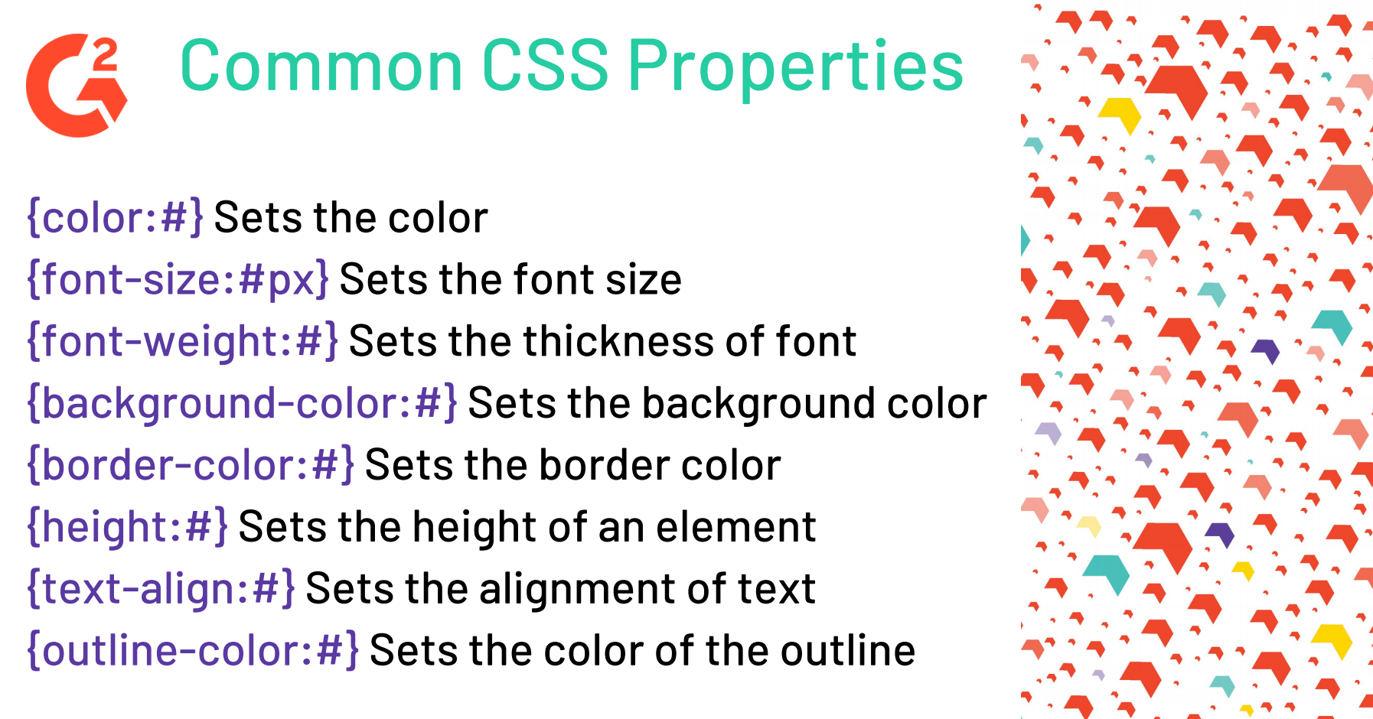

Slide 20
What is Selector?
A CSS selector is a pattern to match the elements on a web page.
The style rules associated with that selector will be applied to the elements that match the selector pattern.
Selectors are one of the most important aspects of CSS as they allow you to target specific elements on your web page in various ways so that they can be styled.
Several types of selectors are available in CSS.

Slide 21
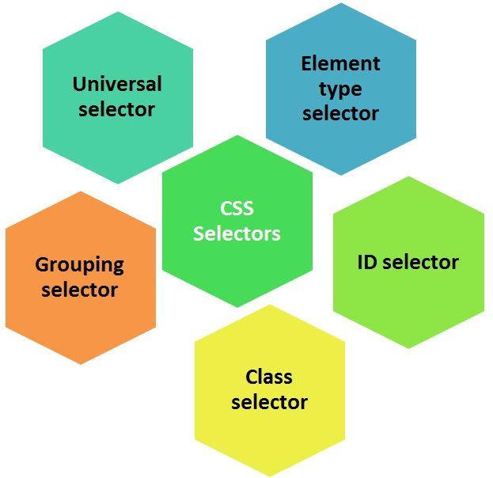

Slide 22

UNIVERSAL SELECTORS
Rather than selecting elements of a specific type, the universal selector quite simply matches the name of any element type
* {
color: red;
}
Output: This rule renders the content of every element in our document in black.

Slide 23
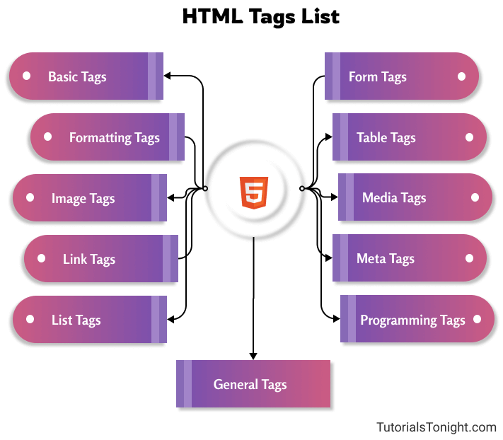
ELEMENT SELECTORS
The element selector selects elements based on the element name. You can select all p elements on a page like this (in this case, all p elements will be center-aligned, with a red text color).
p {
text-align: center;
color: red;
}

Slide 24
#
ID SELECTORS
The id selector uses the id attribute of an HTML element to select a specific element.
The id of an element should be unique within a page, so the id selector is used to select one unique element!
To select an element with a specific id, write a hash (#) character, followed by the id of the element.
The style rule below will be applied to the HTML element with id=”para1″:
#paragraph{
color: green;
text-align: center;
}

Slide 25
.
CLASS SELECTORS
The class selector selects elements with a specific class attribute.
To select elements with a specific class, write a period (.) character, followed by the name of the class.
In the example below, all HTML elements with class=”center” will be green and center-aligned:
.heading{
color: green;
text-align: center;
}

Slide 26
GROUPING SELECTORS
If you have elements with the same style definitions
h1,h2,h3 {
text-align: center;
color: blue;
}
p {
text-align: center;
color: blue;
}

Slide 27
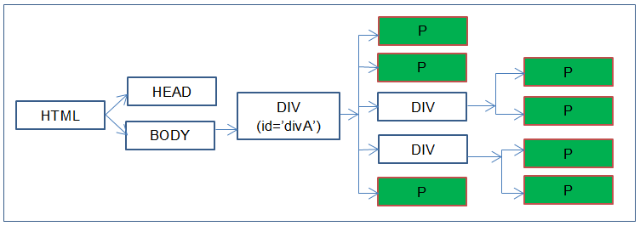
Descendant Selector
Selects all specified descendant child elements under the parent element.
div p { color green;}

Slide 28
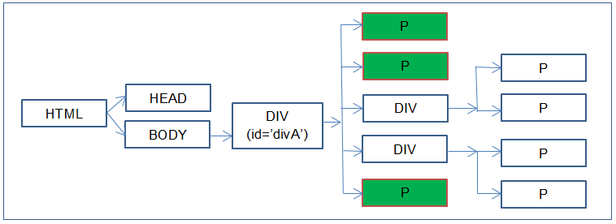
Child Selector
Child selector is used to match all the elements which are children of a specified element.
div > p { color:green;}

Slide 29
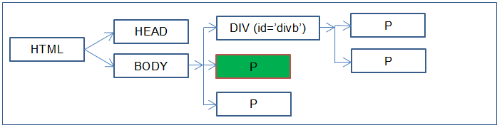
Adjacent Sibling Selector
Selects specified elements which are immediate to an adjacent element.
div + p { color:green;}

Slide 30
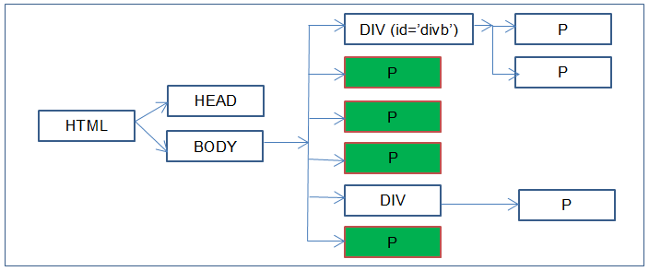
General Sibling Selector
Selects all specified elements which are siblings to an adjacent element.
div ~ p { color:green;}

Slide 31
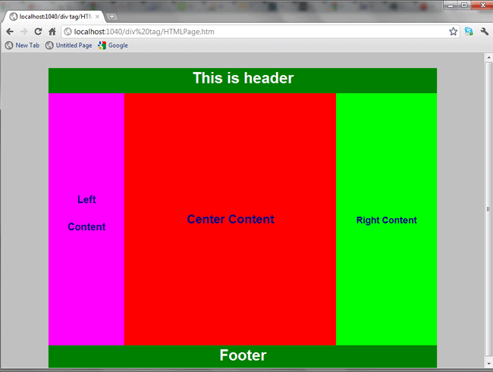
<div>
The <div> tag defines a division or a section in an HTML document. The <div> tag is used as a container for HTML elements – which is then styled with CSS. The <div> tag is easily styled by using the class or id attribute. Any sort of content can be put inside the <div> tag!

Slide 32
The div tag is known as Division tag.
The div tag is used in HTML to make divisions of content in the web page like (text, images, header, footer, navigation bar, etc).
Div tag has both open(<div>) and closing (</div>) tag and it is mandatory to close the tag.
The Div is the most usable tag in web development because it helps us to separate out data in the web page and we can create a particular section for particular data or function in the web pages.
CSS html
. container{ <div class=“container”>
max-width:1080px; </div>
margin:0 auto;
}

Slide 33
Block level and inline elements
HTML elements can be divided into two categories :
Block level and inline elements.
1. HTML block level elements can appear in the body of an HTML page.
2. It can contain another block level as well as inline elements.
3. By default, block-level elements begin on new lines.
4. block level elements create larger structures (than inline elements).
List of block level elements
p
h1, h2, h3, h4, h5, h6
ol, ul
pre
address
dl
div
fieldset
form
hr
table

Slide 34
inline elements
1. HTML inline level elements can appear in the body of an HTML page.
2. It can contain data and other inline elements.
3. By default, inline elements do not begin on new lines.
4. inline elements create shorter structures (than block level elements).
List of inline elements
b, big, i, small
abbr, acronym, em, strong, a, br, img, script, span, sub, sup
button, input, label, select, textarea

Slide 35




Font
There are many properties related to the font, such as the face, weight, style, etc. These properties allow you to change the style or complete look of your text.
The fonts add value to your text. It helps readers to perceive information from the text. The correct choice of color, font and text size can prove to be vital for attracting your target audience.

Slide 36
Font-Family
font-family: 'Segoe UI', Tahoma, Geneva, Verdana, sans-serif;
The font-family property specifies the font for an element.
The font-family property can hold several font names as a "fallback" system. If the browser does not support the first font, it tries the next font.
There are two types of font family names:
family-name - The name of a font-family, like "times", "courier", "arial", etc.
generic-family - The name of a generic-family, like "serif", "sans-serif", "cursive", "fantasy", "monospace".
Start with the font you want, and always end with a generic family, to let the browser pick a similar font in the generic family, if no other fonts are available.
Value | Description
family-name / generic-family | A prioritized list of font family names and/or generic family names
initial | Sets this property to its default value.
inherit | Inherits this property from its parent element.

Slide 37
Font-Size
font-size: larger;
The CSS font-size property is used to set the size of font. We can specify the value in percentages, units like pixels, cm, points, em, etc. and absolute keyword. Relative values maximize accessibility. The default font-size is 16px or 12pt.
Syntax
The syntax of CSS font-size property is as follows −
Selector { font-size: /*value*/ }
Note: If you do not specify a font size, the default size for normal text, like paragraphs, is 16px (16px=1em).

Slide 38
Set Font Size With Pixels
Setting the text size with pixels gives you full control over the text size:
Example
h1 { font-size: 35px; } p { font-size: 20px; }

Slide 39
Set Font Size With Em
Example
h1 { font-size: 3em; } h2 { font-size: 1.875em; } p { font-size: 0.875em; }

Slide 40
Use a Combination of Percent and Em
The solution that works in all browsers, is to set a default font-size in percent for the <body> element:
Example
body { font-size: 80%; } h1 { font-size: 3.5em; }

Slide 41
Responsive Font Size
The text size can be set with a vw unit, which means the "viewport width".
Example
body{
<h1>welcome to kgisl<h1>
}
h1{
font-size:9vw
}

Slide 42
Set Font Size Using Keywords
xx-small (9px)
x-small (10px)
small (13px)
medium (16px)
large (18px)
x-large (24px)
xx-large (32px)
Smaller
Larger
Inherit

Slide 43
Font-Style
font-style: normal;
font-style: italic;
font-style: oblique;
font-style: inherit;
Value | Description
normal | The browser displays a normal font style. This is default
italic | The browser displays an italic font style
oblique | The browser displays an oblique font style
initial | Sets this property to its default value. Read about initial
inherit | Inherits this property from its parent element. Read about inherit

Slide 44
Font-Variant
font-variant: normal;
font-variant: small-caps;
font-variant: inherit;
Example
p{
font-variant:normal;
}
h1{
font-variant:small-caps;
}

Slide 45
Font-Weight
font-weight: bold;
Value | Description
normal | Defines normal characters. This is default
bold | Defines thick characters
bolder | Defines thicker characters
lighter | Defines lighter characters
100 200 300 400 500 600 700 800 900 | Defines from thin to thick characters. 400 is the same as normal, and 700 is the same as bold
initial | Sets this property to its default value.
inherit | Inherits this property from its parent element.

Slide 46
font CSS shorthand property
The font CSS shorthand property sets all the different properties of an element's font.
The font property is a shorthand property for:
font-style
font-variant
font-weight
font-size/line-height
font-family
Note: The font-size and font-family values are required. If one of the other values is missing, their default value are used.
Example
Use font to set several font properties in one declaration:
.para { font: 15px Arial, sans-serif; } .para1 { font: oblique normal bolder 15px Arial, serif; }

